Slide 1
Project Application Development
Bindu, Assem, Justice, Joud and Justin

Slide 2
Introduction
General Information
Mathematical Models
UML
Application
Summary and Conclusion

Slide 3
General Information
Project Plan
Meetings
Agendas and Minutes

Slide 4
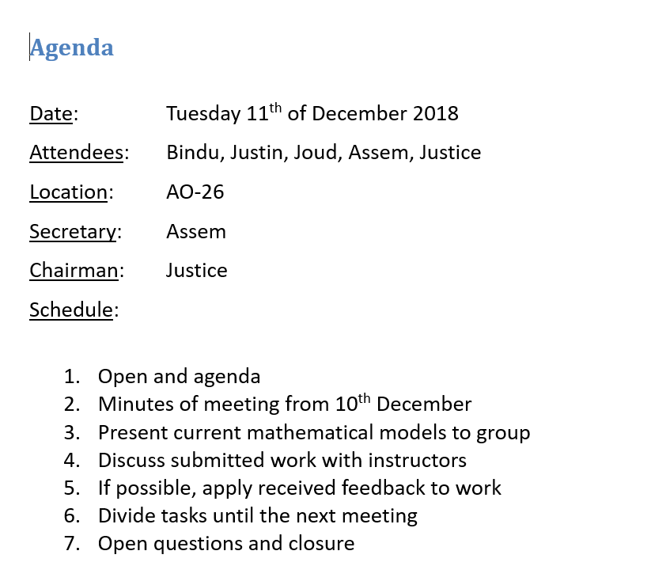

Slide 5
What is the best ethically acceptable measure which can be taken to improve the ecological balance in the Oostvaardersplassen?
Needs of the client
Available models
Variables to be used
Models simple enough
Application

Slide 6
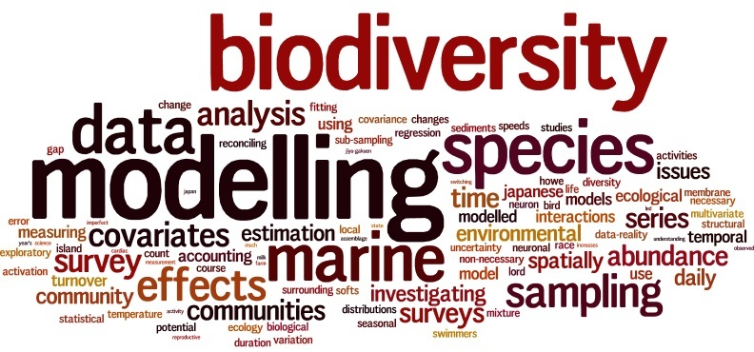
Why Modeling ?

Slide 7
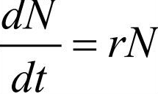
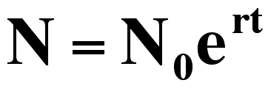
Mathematical Models
The math model for exponential growth :

Slide 8
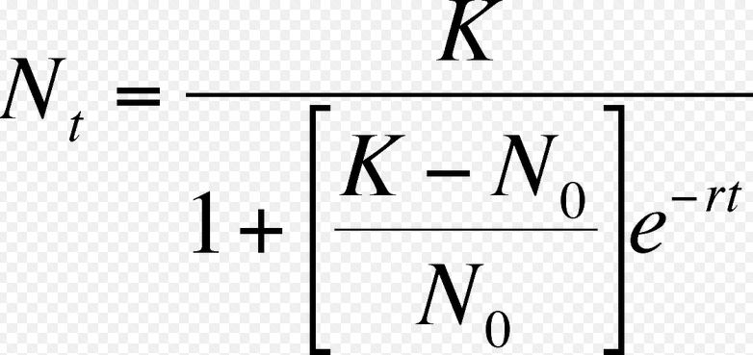
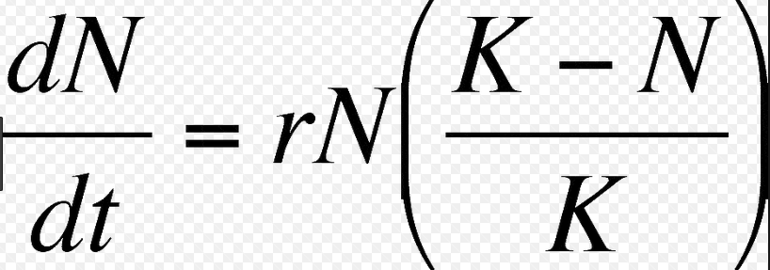
The logistic model growth:

Slide 9
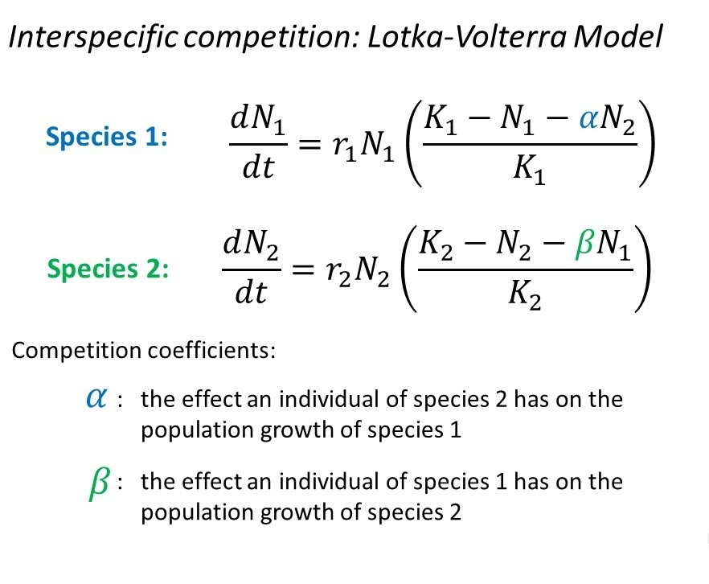
Interaction between large herbivores (Cattle and horses)

Slide 10
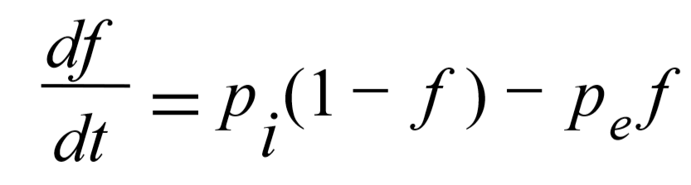
Model with migration effect (Simple metapopulation growth rate)

Slide 11
UML
Highest priority features:
Project the predictions in a graph
Display results of different animals
Switch between different mathematical models
Alter initial data, capacity and starting amount of each amount

Slide 12
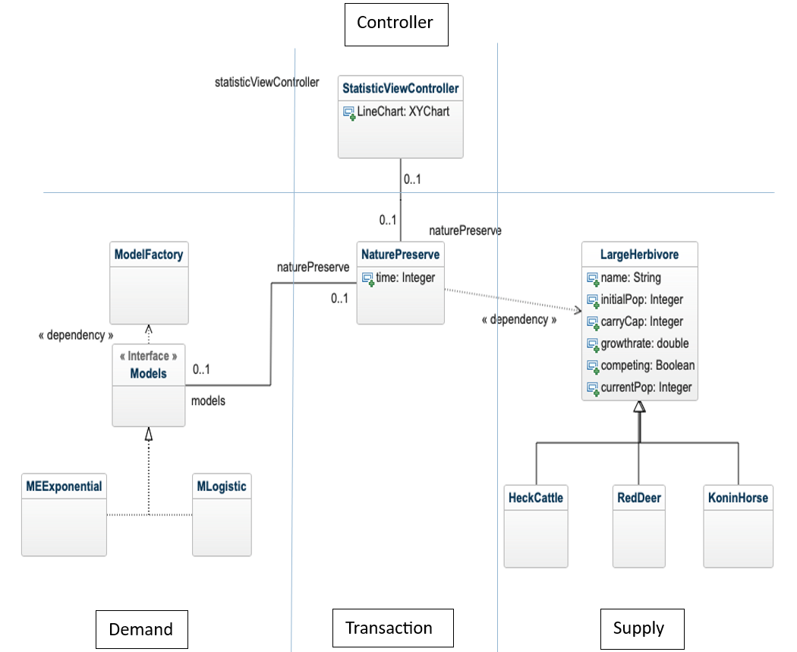
Domain Model

Slide 13
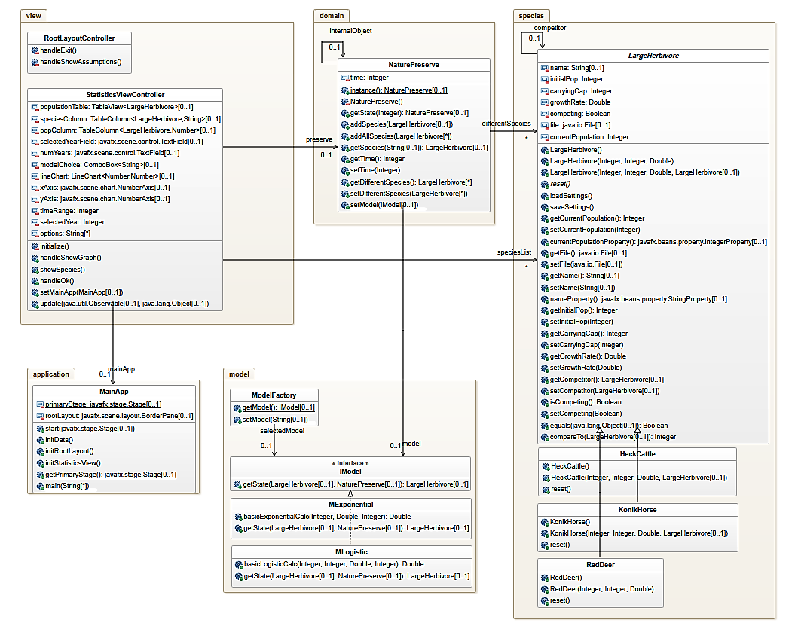
Class Diagram

Slide 14
Application
Made initial data editable by expert
Used lots of design patterns
Made code as scalable as possible
Code is, to this point, very structured

Slide 15
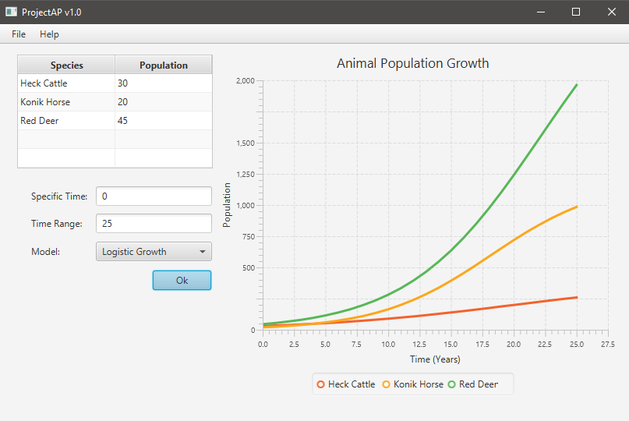
Application

Slide 16
Back to the features
Highest priority features:
Project the predictions in a graph
Display results of different animals
Switch between different mathematical models
Alter initial data, capacity and starting amount of each amount

Slide 17
Summary and Conclusion
Answer to question still unknown
Models not yet advanced
Application is structured
Questions?

